Slide 1
Welcome to my project

Slide 2
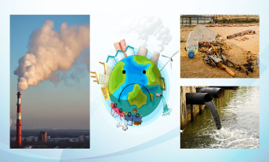
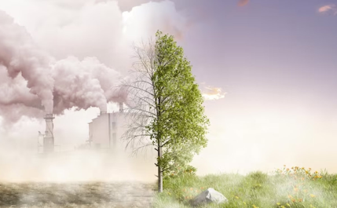
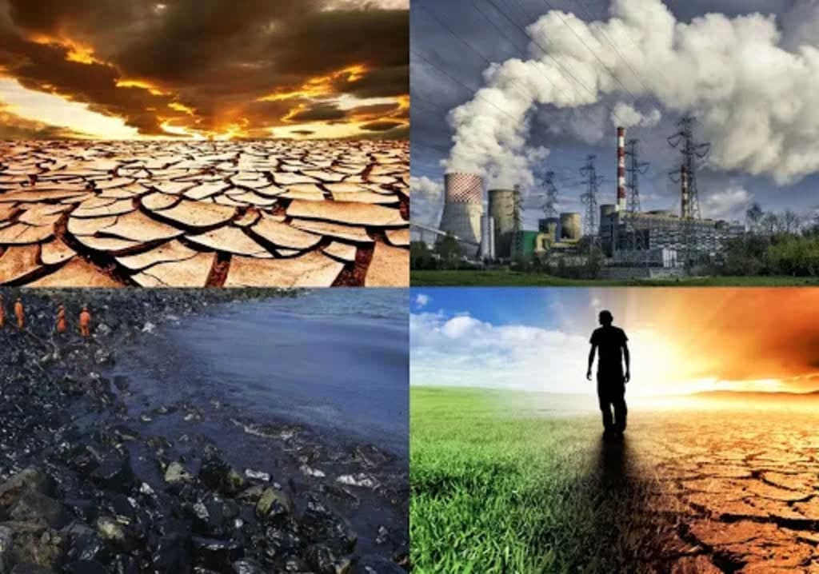
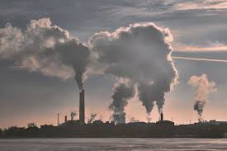
pollution

Slide 3
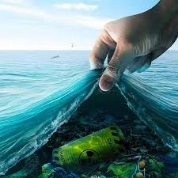
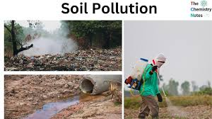
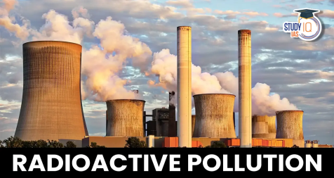
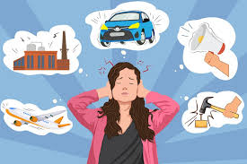
Types of pollution
Air pollution.
Water pollution.
Soil pollution.
Radioactive pollution.
Noise pollution.

Slide 4
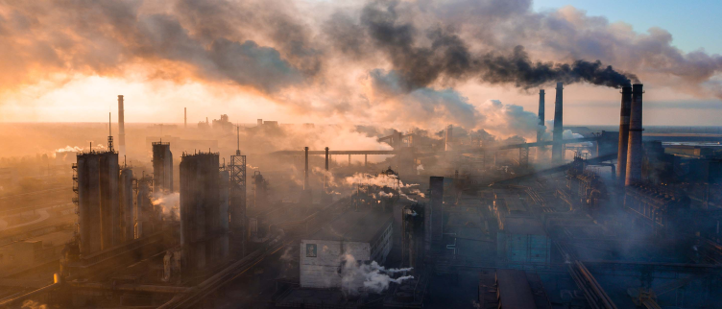
Air pollution
What is air pollution?
Air pollution is contamination of the indoor or outdoor environment by any chemical, physical or biological agent that modifies the natural characteristics of the atmosphere. Household combustion devices, motor vehicles, industrial facilities and forest fires are common sources of air pollution.

Slide 5
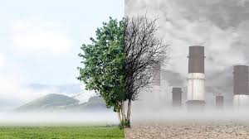
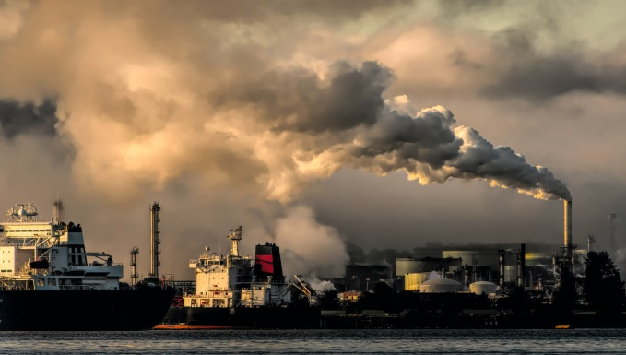
WHAT are the CAUSES of air POLLUTION?
Air pollution is caused by solid and liquid particles and certain gases that are suspended in the air. These particles and gases can come from car and truck exhaust, factories, dust, pollen, mold spores, volcanoes and wildfires. The solid and liquid particles suspended in our air are called aerosols.

Slide 6

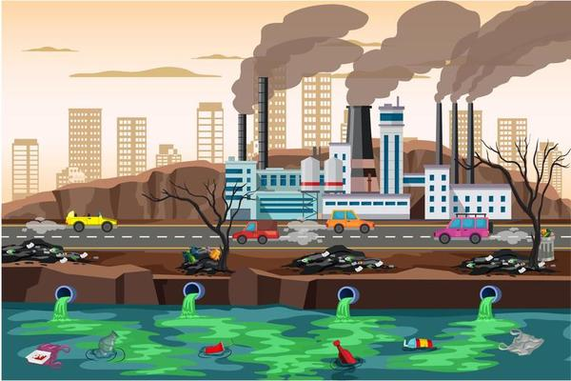
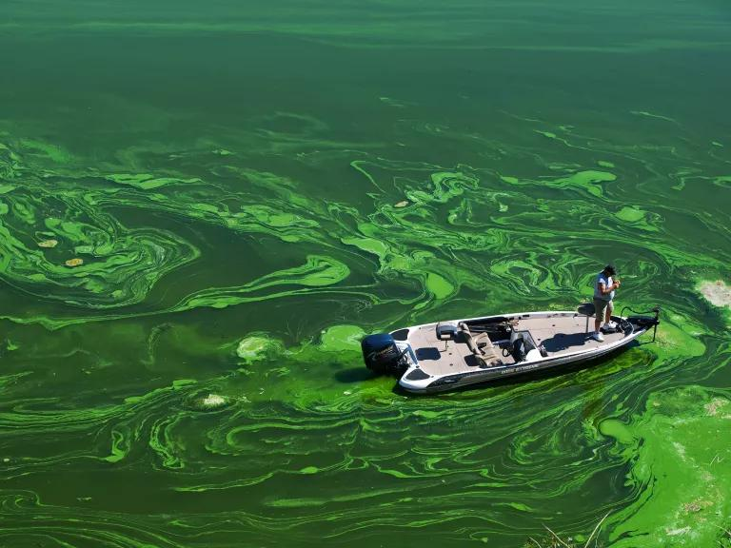
Water pollution
What is water pollution?
Water pollution occurs when harmful substances—often chemicals or microorganisms—contaminate a stream, river, lake, ocean, aquifer, or other body of water, degrading water quality and rendering it toxic to humans or the environment. This widespread problem of water pollution is jeopardizing our health.

Slide 7
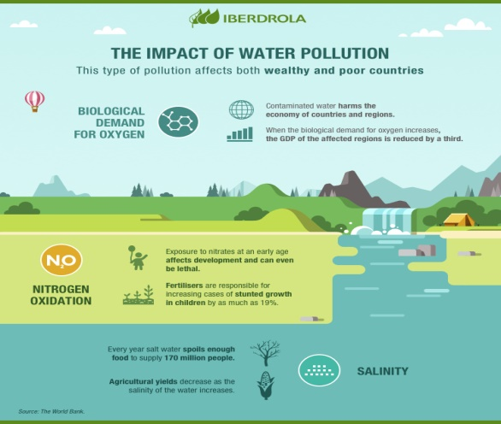
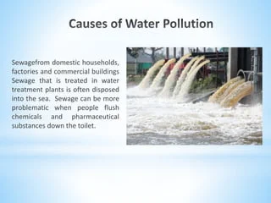
What are the causes of water pollution?
The main water pollutants include bacteria, viruses, parasites, fertilisers, pesticides, pharmaceutical products, nitrates, phosphates, plastics, faecal waste and even radioactive substances. These substances do not always change the colour of the water, meaning that they are often invisible pollutants.

Slide 8
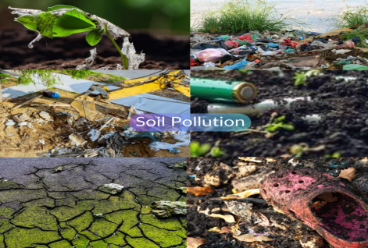
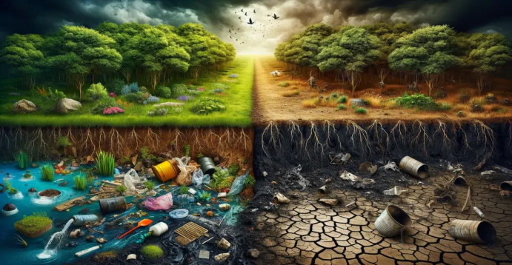
Soil pollution
What is soil pollution?
Soil pollution refers to the contamination of soil with anomalous concentrations of toxic substances. It is a serious environmental concern since it harbours many health hazards. For example, exposure to soil containing high concentrations of benzene increases the risk of contracting leukaemia.

Slide 9
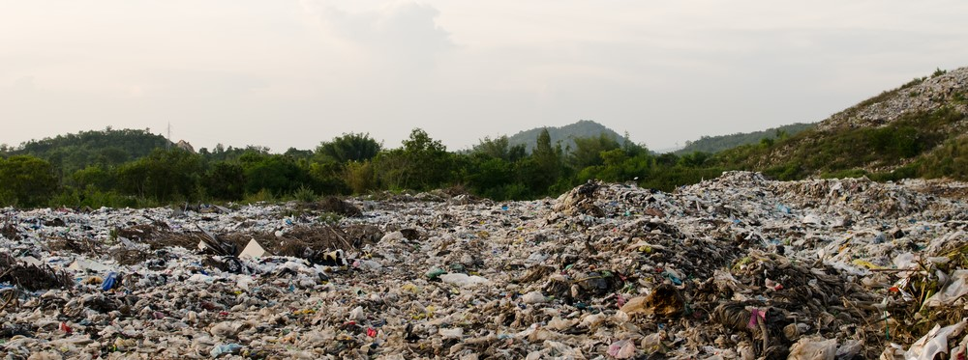
What are the causes of soil pollution?
The Main Causes of Land Pollution. While there are many causes of land pollution, the main contributors include litter, waste, urbanization, construction, mining, extraction and agriculture. Let's dive into how these different issues lead to increased land pollution

Slide 10
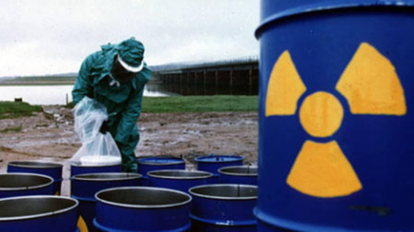
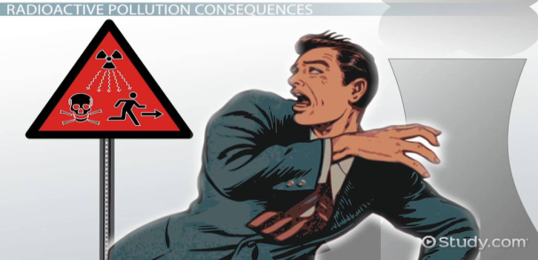
Radioactive pollution
What is radioactive pollution?
Radioactive pollution is defined as a form of physical, nuclear pollution to living organisms and the environment (hydrosphere, lithosphere, and atmosphere) arising from exposure to the release of ionizing radiation from radioactive elements such as uranium.

Slide 11
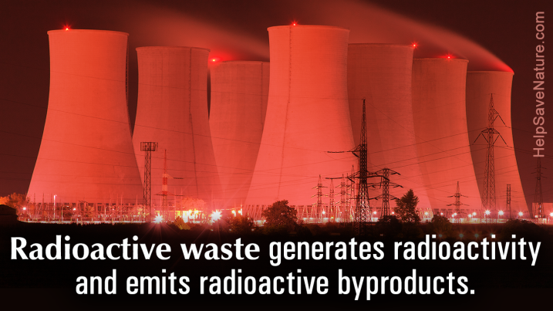
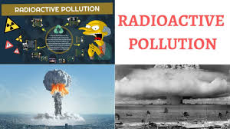
What are the causes of radioactive pollution?
The sources of radioactive pollution include mining for nuclear material, nuclear power plants, nuclear weapons and their testing, as well as medical diagnostics and treatment procedures. The consequences of radioactive pollution may be nothing at all, if it's something small and transient.

Slide 12
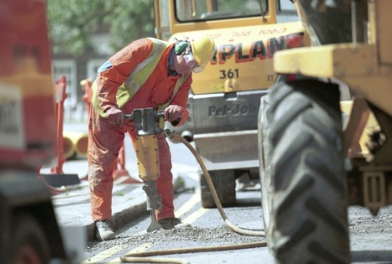
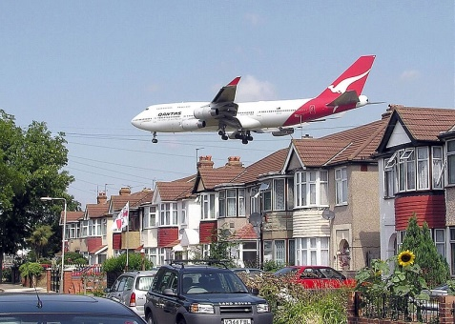
Noise pollution
What is Noise pollution?
Not all sound is considered noise pollution. The World Health Organization (WHO) defines noise above 65 decibels (dB) as noise pollution. To be precise, noise becomes harmful when it exceeds 75 decibels (dB) and is painful above 120 dB.

Slide 13
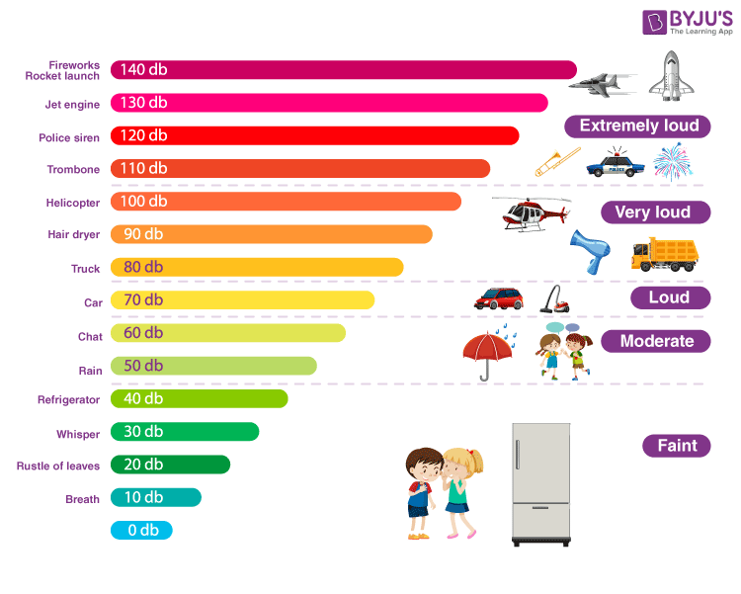
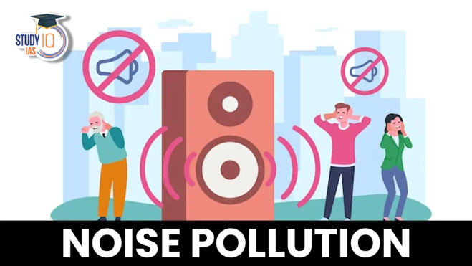
What are the causes of noise pollution?
Some of its major causes are vehicles, aircraft, industrial machines, loudspeakers, crackers, etc. When used at high volume, some other appliances also contribute to noise pollution, like television, transistor, radio, etc.

